Slide 1
Indianapolis Flight
February 16, 2013
West-northwest winds
Two vertical profiles
4 survey transects across city
3 downwind transects
Boundary layer depth grew over duration of flight (initial – 1040 m, final – 1440 m)
GPS malfunction during downwind transects

Slide 2
Flight Path – original (we lost GPS lock during 1st downwind transect at ~350 m and halfway through 2nd at ~500 m)

Slide 3
Flight Path - corrected
298 deg
Notes:
Flight path corrected from original data where GPS stopped working during the downwind transects. Vertical Profile 1 began on way to Indy and spiral descent on SW side of city. Four surveys of the city at approximately 600m were followed by 3 downwind transects at different heights. Vertical Profile 2 began with spiral ascent and then descent on return to W. Lafayette.

Slide 4
CO₂ Calibration

Slide 5
CH₄ Calibration

Slide 6
Time Series Distribution
Notes:
Calibration sections are removed from CO2, CH4 and H2O

Slide 7
Upwind Transect – CO₂
Notes:
Upwind CO2 concentrations are higher than downwind possibly due to increase in depth of boundary layer. This upwind transect was taken when boundary layer was still 1040 m. Note the bright green at ~-40 km. There appears to be a source further upwind of the city at the southwestern side. Check out 3D plot in slide number 10.

Slide 8
Upwind Transect – CH₄
Notes:
Upwind CH4 concentrations are similarly higher than downwind due to the increase in depth of the boundary layer. Check out the CH4 signal at ~-18 km from Twin Bridges LF!

Slide 9
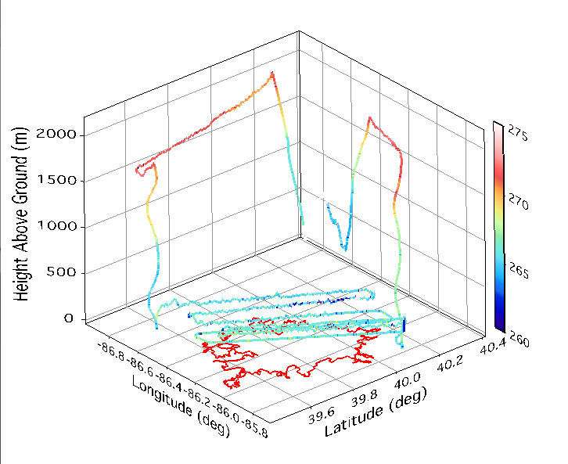
Survey – Potential Temperature (K)
θ(K)

Slide 10
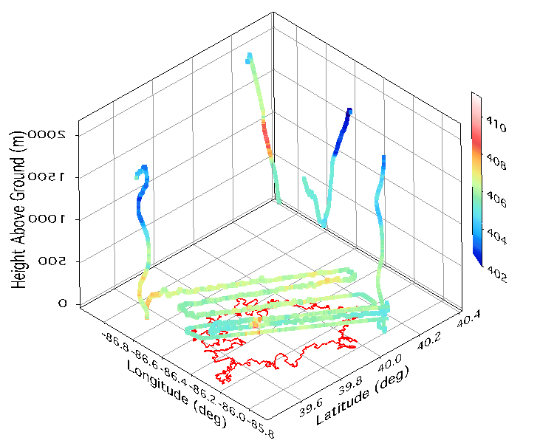
Survey – CO₂ (ppm)
CO₂ (ppm)
2000
1500
1000
500

Slide 11
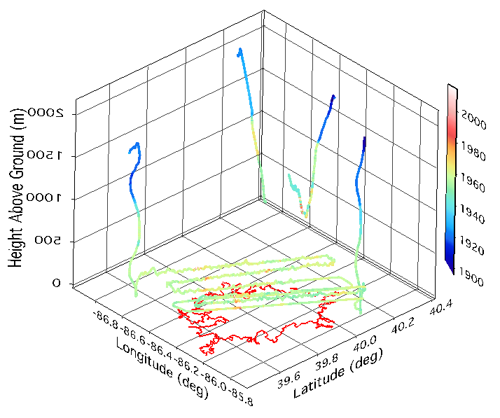
Survey – CH₄ (ppm)
CH₄ (ppb)
2000
1500
1000
500

Slide 12
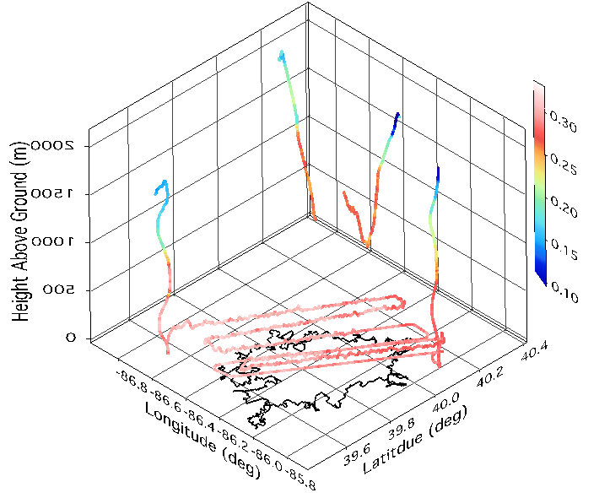
Survey – H₂O (%)
H₂O (%)
2000
1500
1000
500

Slide 13
Downwind Transects – CO₂
Notes:
GPS was lost before transect 1 (~350 m) and was out through half of transect 2 (~500 m). By transect 3 (~420 m), GPS was functioning.
Concentrations close to the edges of the transects are lower than the observed upwind concentrations. Distinct hotspots in CO2 in the SW side due to Harding Street Power Plant were observed. Transects were just long enough to cover the city width.

Slide 14
Downwind Transects – CH₄
Notes:
Concentrations close to the edges of the transects are lower than that of upwind at this time. Distinct CH4 hotspot in SW side due to the Southside Landfill were also observed.

Slide 15
Vertical Profiles – H₂O, Θ, var(VW)
Notes:
Vertical profile 1 – ascent on way to Indy, descent spiral over SW side of Indy
Vertical profile 2 – ascent spiral over NE side of Indy, descent on way back to W. Lafayette
Growth of boundary layer depth visible between the two vertical profiles

Slide 16
Vertical Profiles – CO₂ and CH₄
Notes:
Vertical profile 1 – ascent on way to Indy, descent spiral over SW side of Indy
Vertical profile 2 – ascent spiral over NE side of Indy, descent on way back to W. Lafayette

